Slide 1
edU: Iteration 3
Zachery Gentry, Tousar Mohammed, Giannina Pachas and Courtney Howland

Slide 2

Vision Statement Reminder
We are creating a mobile app which focuses on image recognition capabilities in an educational environment.
(Image 1)

Slide 3
Overview
Current and Future Iteration
Changes made since last iteration
Risk
Addressing the Team
Demo

Slide 4
Current and Future Iteration Plan
For Iteration 3:
Numbers
Alphabet
UI design
Audio samples created
For Next Iteration:
Implement Audio samples
Shapes
Math
3 - letter words
Update Lesson

Slide 5
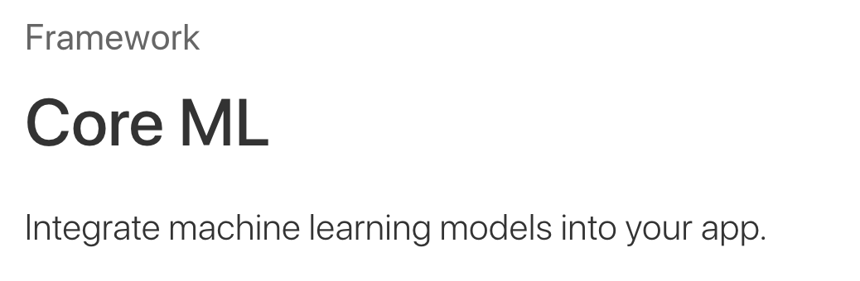
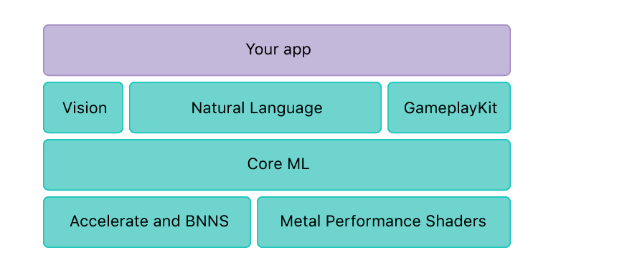
(Image 2)
(Image 3)

Slide 6
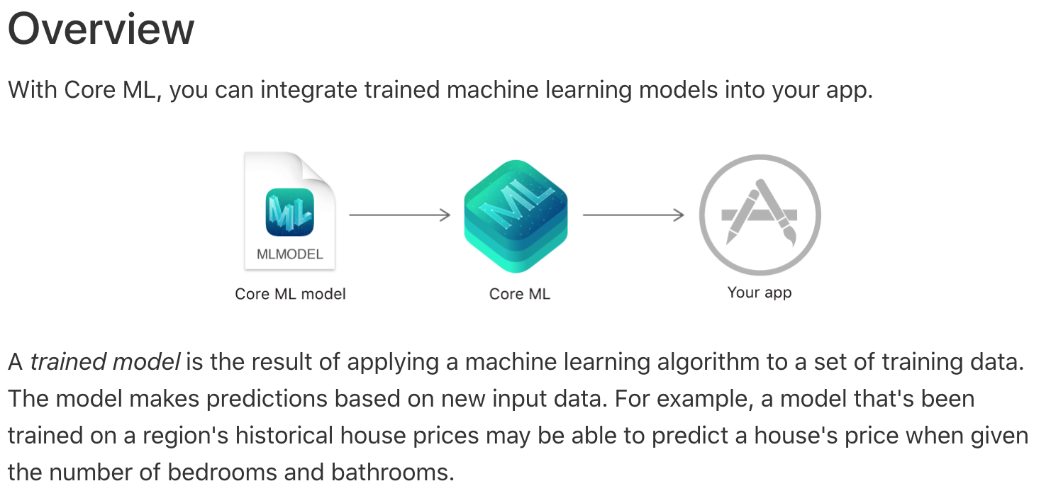
(Image 4)

Slide 8
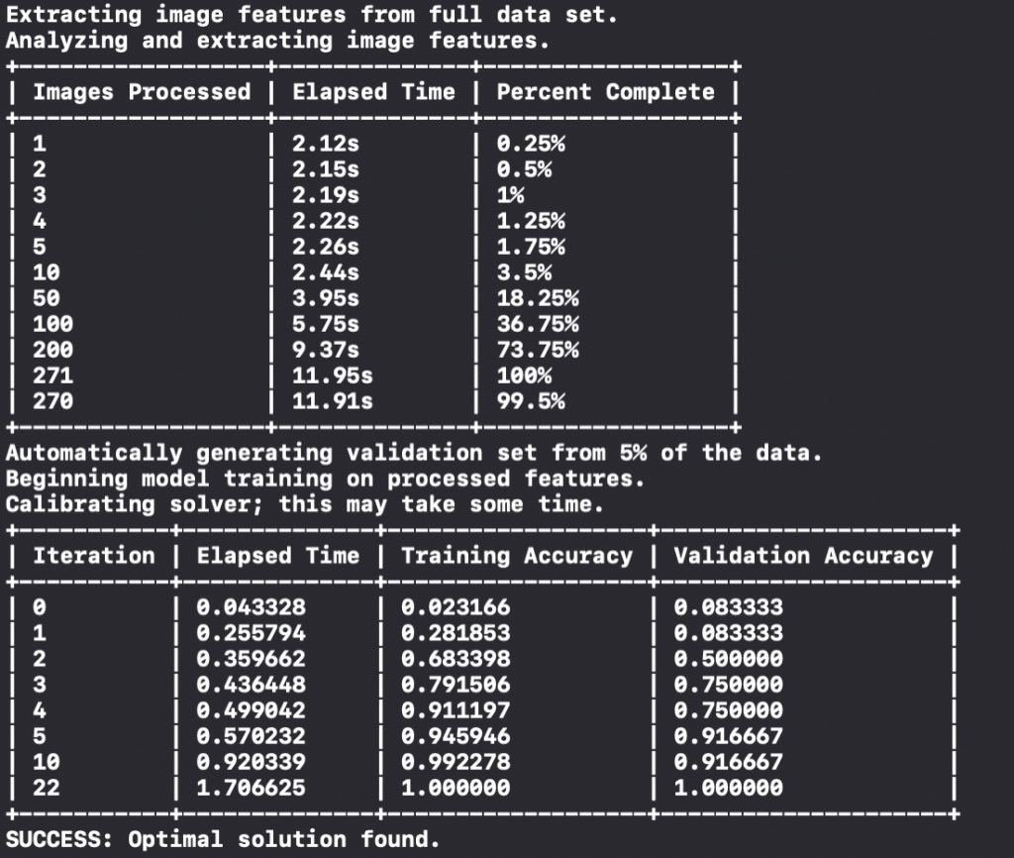

Slide 9
New Risk
Risk : The team is switching recognition platforms to Apple’s Core ML because previous recognition tool did not recognize different handwriting as well as we wanted.
●Risk Exposure: RE = 100% * 10 hr = 10 hr
●Solution: The team will split up the work among the members to train our own model with different handwriting for letters, words, numbers, shapes.

Slide 10

Addressing the Review Team
Question 1: This app has features of Text Recognition, which uses Amazon Recognition API, that requires network connectivity. But on documentation, it says, “The app does not rely on network connectivity, everything is done locally in the app.” How would you justify that?
The team is no longer relying on an Amazon's API, they will be creating their own machine learning model through Apple's Core ML technology.
(Image 5)

Slide 11
Addressing the Review Team cont...
Question 2: Since this app is primarily targeted for kids, is there a “skip" option in case user gets stuck on a question? Will there be a “similar question” choice or will the user not be able to continue until question is correctly answered?
No, there is no skip option. The child will be required to give an answer. If they cannot, then either an adult will be there to assist, or they will be expected to review the more basic lessons and try again
Question 3: Since this app is intended for childrens, how are they expected to know to hit the submit button after drawing on the screen?
Any child that is too young to press the "Submit" button should not be on a electrical device without the supervision of an adult nearby. In this case, the adult would be obliged to help them.

Slide 12
Resources
Modified: https://pixabay.com/en/nature-green-natural-green-leaves-3337499/(Image 1)
http://www.pcyc.org.au/Clubs/Redlands/Basketball/Juniors.aspx (Image 5)
https://developer.apple.com/documentation/coreml (Image 2, 3, 4)

Slide 13
Demo

